Slide 1
Nakuja Internship
Avionics Progress Report Week 3 Junn Hope

Slide 2
Tasks completed last week
[#Issue 30] : Research on camera module
[#Issue 51]: Inquire about GEGIS drone
[#Issue 30] : Research on Ground Station Dashboard – In progress

Slide 3
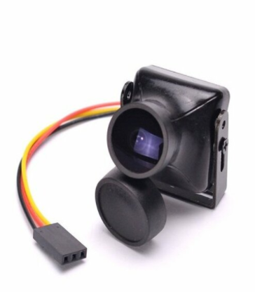
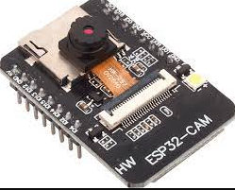
[#Issue 30] : Research on camera module
We researched on plausible camera modules that we can use for video transmission in real time form the rocket to the ground station.
We tested two modules:
ESP32CAM
FPV Drone Camera
ESP32 CAM FPV Drone camera

Slide 4
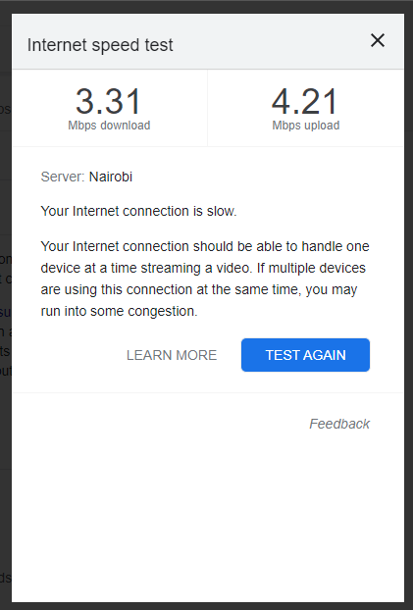
ESP32 CAM
The ESP32 cam provided clear video feed over a short range, beyond which the clarity was significantly reduced and video lag increased.
However, these results are dependent on the Wi-Fi strength of the network to which the ESP32 is connected to.
The results of the test carried out are as shown in the figures below:
Wi-Fi signal strength

Slide 5
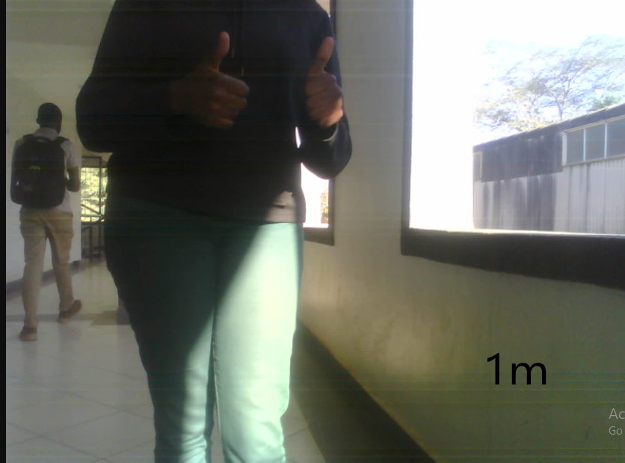
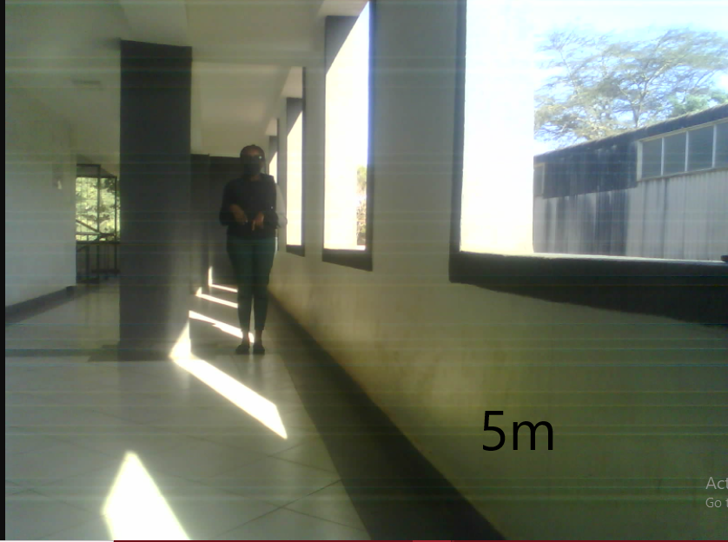
Clarity of ESP32 at varying distances

Slide 6
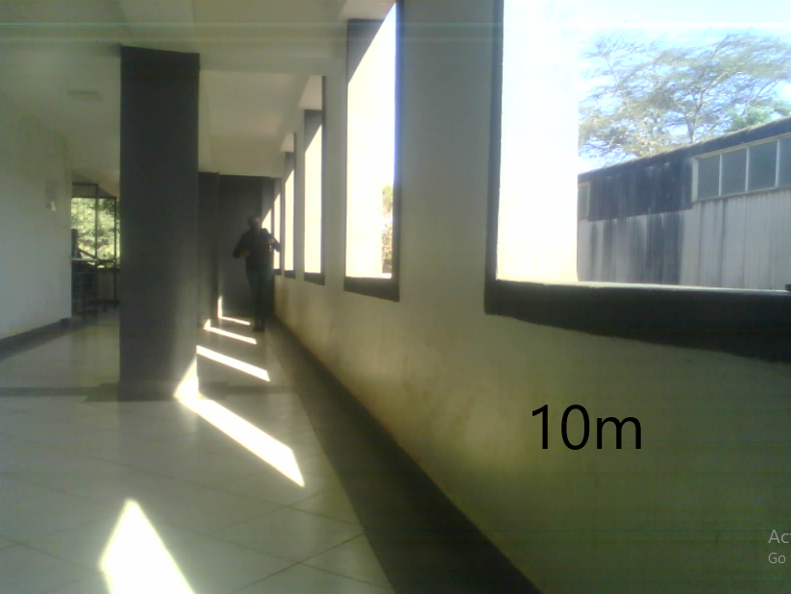
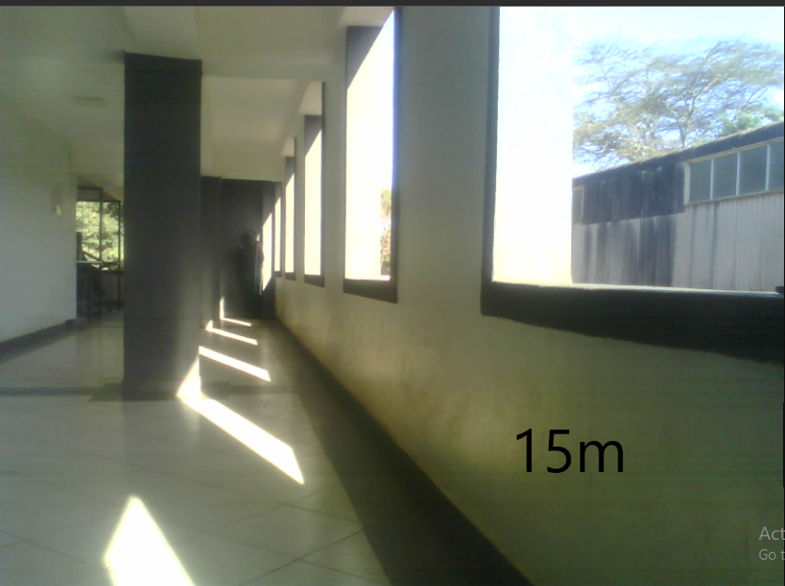

Slide 7
FPV Drone Camera
We tested the FPV drone camera that gave impeccable results over a greater distance of up to 1km.
We noticed that the pointing direction of the receiving and transmitting antennas affected the clarity of the reception.
The camera and its antennas must be connected to 12v supply, which is 4.6volts above our intended 7.4V supply.
The test results are as shown in the figures below

Slide 8
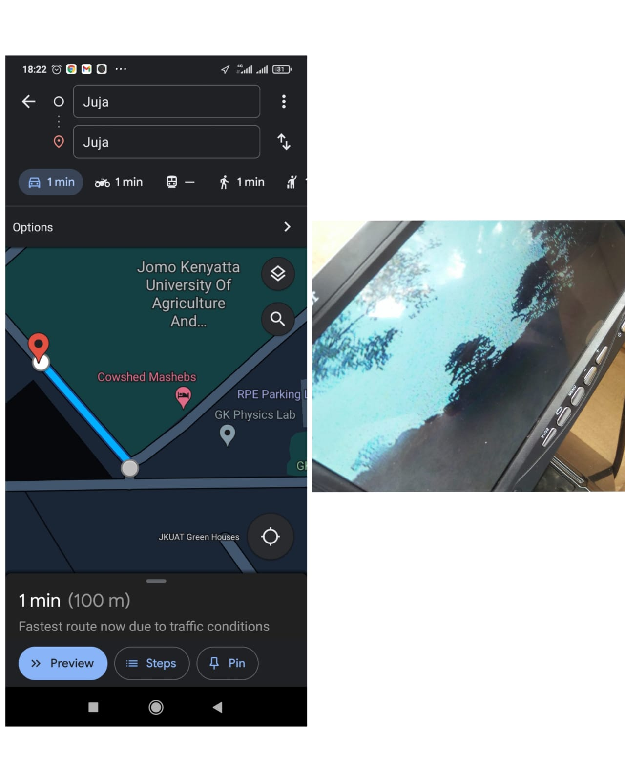
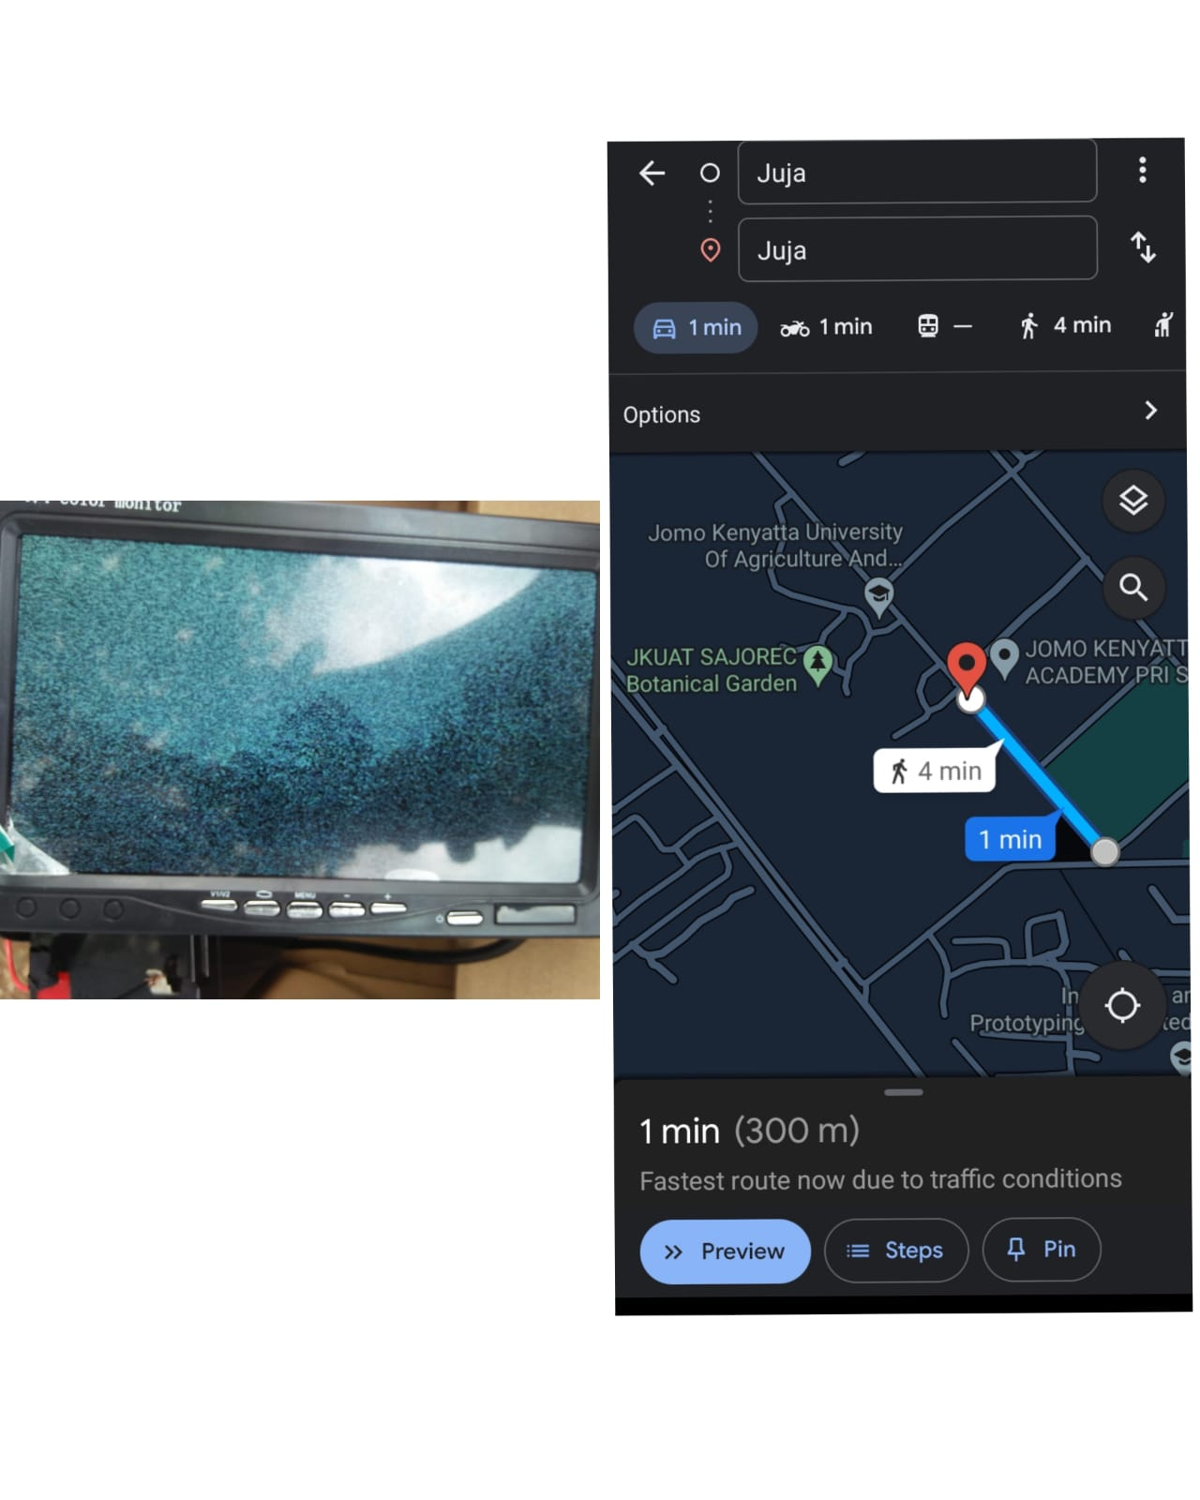

Slide 9
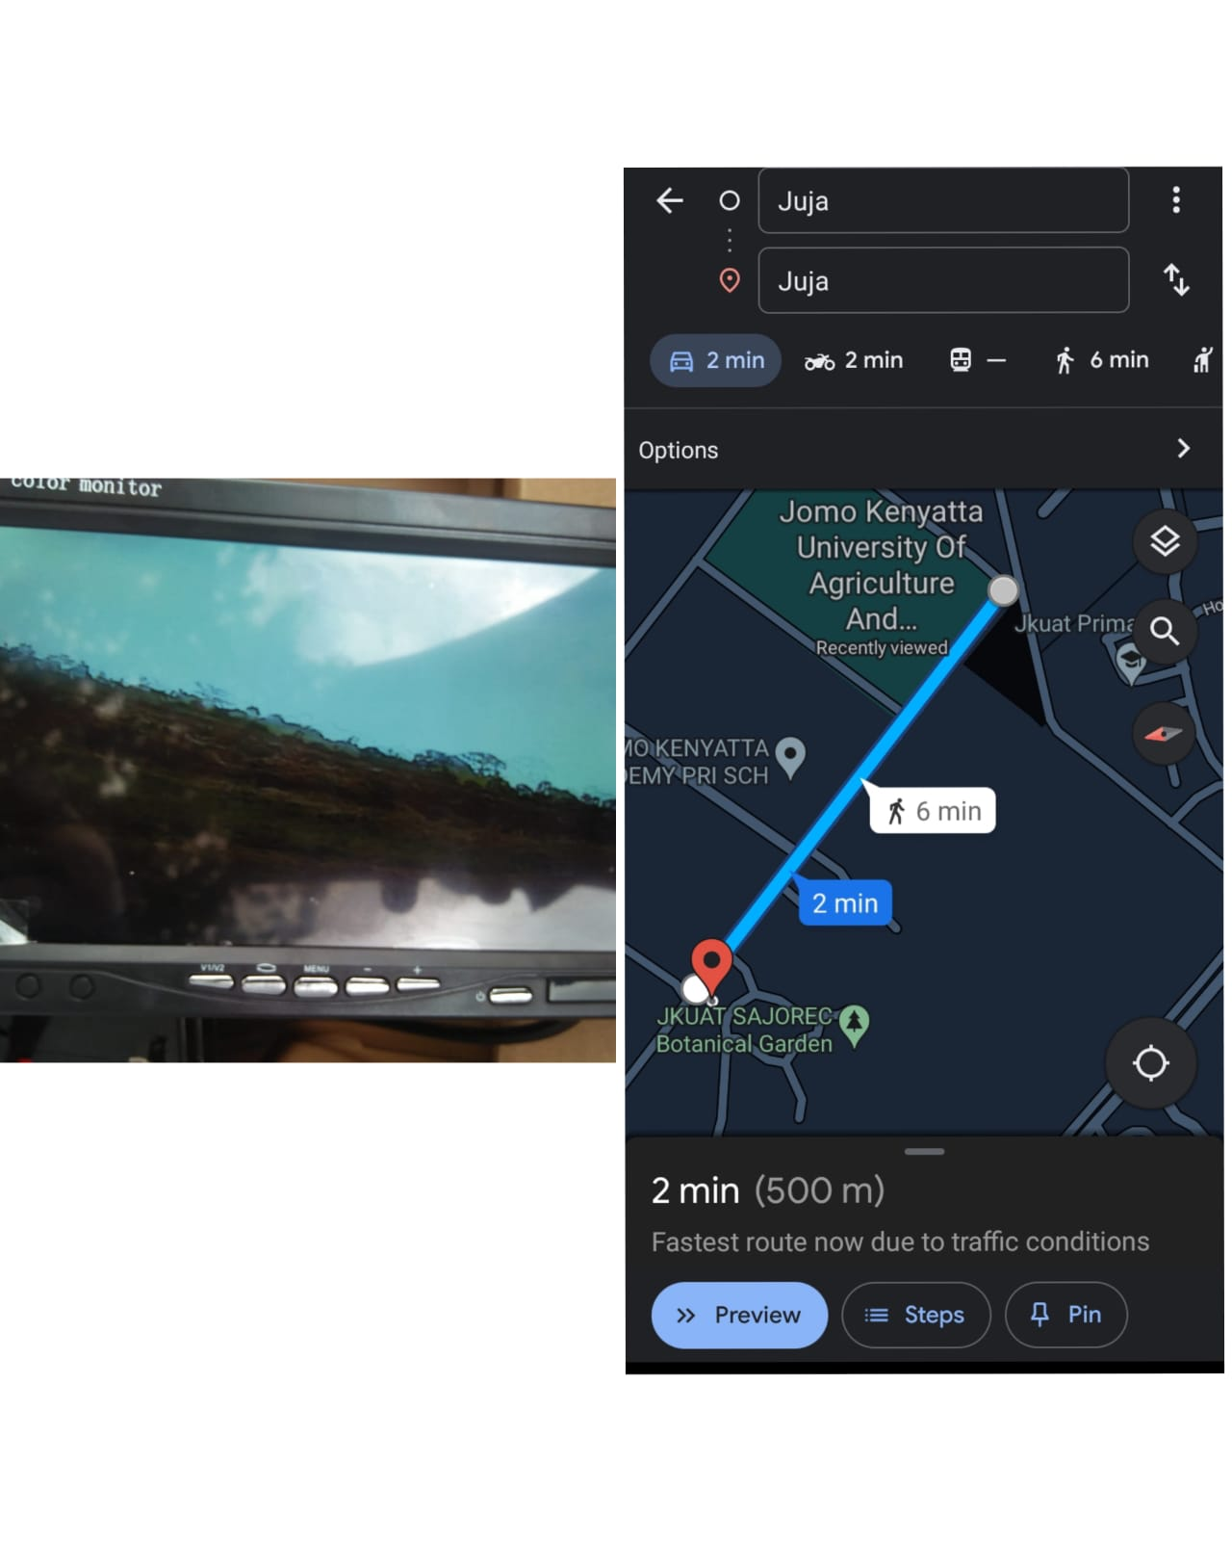
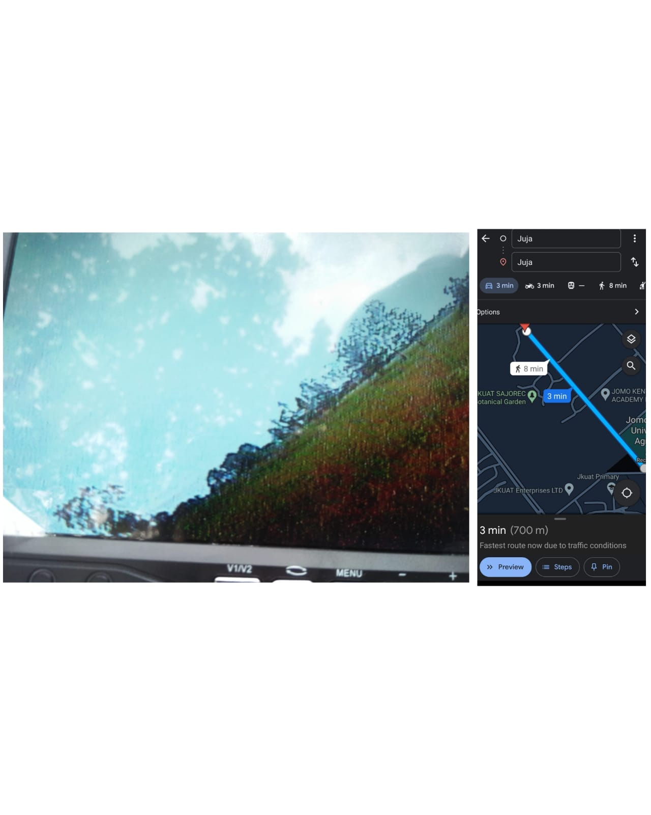

Slide 10
[#Issue 51]: Inquire about GEGIS drone
Following week 2’s inquiry on the drone, we got the go ahead to use the drones for the tests.
The tests are to be done on Week 5.

Slide 11
Tasks in this week
[#Issue 3]: Avionics bay design
[#Issue 18] : Launch pad design
[#Issue 30] : Research on Ground Station Dashboard
[#Issue 31] : Research on apogee detection logic
[#Issue 26] : Improve on Kalman filter performance

Slide 12
Timeline
Month | Intern week | Tasks
Jan | Week 1 | Onboarding Getting acquainted with avionics and telemetry resources
 | Week 2 | Research on ground station & ground station dashboard Research on camera module Research on Data transmission
 | Week 3 | Avionics bay design Launch pad design
Feb | Week 4 | Research on apogee detection logic Improve Kalman filter performance
 | Week 5 | Program Avionics and Telemetry boards
 | Week 6 | Test the boards
 | Week 7 | Testing and launch of N2

